Slide 1





Lazy Page Allocation in xv6-riscv
Submitted By:
Mazen Ahmed
Ahmed Hany
Karim Ahmed
Ayten Hassan
Rodina Ahmed
Instructor:
Dr. Reem ElHalwany

Slide 2

Introduction
What is Lazy Page Allocation?
Lazy Page Allocation is a memory management technique where:
Virtual memory is reserved first
Physical RAM is allocated only when memory is actually used
Instead of allocating all memory immediately, the operating system waits until a page fault occurs.
This technique is also called:
Demand Paging

Slide 3


Why Do We Need Lazy Memory?
Problem in Traditional Allocation In normal xv6:
sbrk() → allocates all physical pages immediately
Problems:
Slow allocation for large memory requests
Wasted RAM for unused pages
Reduced system performance
Fewer processes can run simultaneously
A process may request:
1 GB memory
But only use:
10 MB
The remaining memory is wasted.

Slide 4
Lazy Allocation Solution
Our Solution
Instead of allocating RAM immediately:
Increase virtual memory size only
Wait until memory is accessed
Handle page fault
Allocate page dynamically

Slide 5
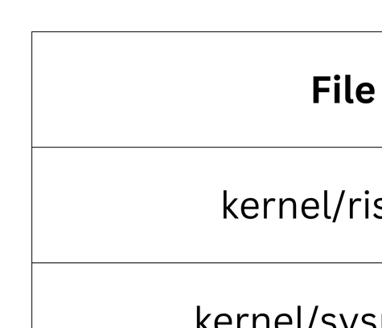
Files Modified

Slide 6
File 1: riscv.h
Purpose: Added page fault cause definitions.
Added functions:
#define CAUSE_LOAD_PAGE_FAULT 13
#define CAUSE_STORE_PAGE_FAULT 15
Importance
These definitions help the kernel:
detect page faults
distinguish between:
read faults
write faults
Without them:
kernel cannot recognize lazy allocation faults.

Slide 7
File 2: sysproc.c
Modified Function: sys_sbrk()
Old Behavior:
sbrk() → immediate RAM allocation
New Behavior
sbrk() → only increases process size
Example:
p->sz += n;
Importance
Makes allocation:
faster
O(1)
independent of memory size
This is the core idea of lazy memory.

Slide 8
File 3: trap.c
Then:
Get fault address
Check if valid
Call:
lazy_alloc()
Importance
This file is the heart of the project because:
it catches the page fault
dynamically allocates memory
resumes program execution
Modified Function
usertrap()
Purpose
Handles:
load page faults
store page faults
Main logic:
if(scause == 13 || scause == 15)

Slide 9
File 4: vm.c
Added Function
lazy_alloc()
Main Tasks
1. Align address
PGROUNDDOWN(va)
2. Allocate physical memory
kalloc()
3. Clear memory
memset()
. Map page
mappages()
Importance
This file performs the actual:
Physical Memory Allocation
Without it:
no RAM pages would be created.

Slide 10
Testing Used
We created multiple tests:
1. Sequential Access Test
Pages accessed one by one.
2. Random Access Test
Pages accessed randomly.
3. Repeated Access Test
Checks that pages are not allocated twice.
4. Performance Test
Compares lazy allocation with eager allocation.

Slide 11
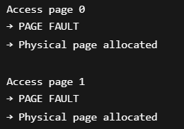
Sequential Access Output
Result:
each page faults once
allocation occurs only when needed

Slide 12
Random Access Output
Random Pattern
3 → 7 → 1 → 5 → 0
Observation:
only touched pages get physical RAM
untouched pages remain lazy
This proves:
Demand Paging Works Correctly

Slide 13
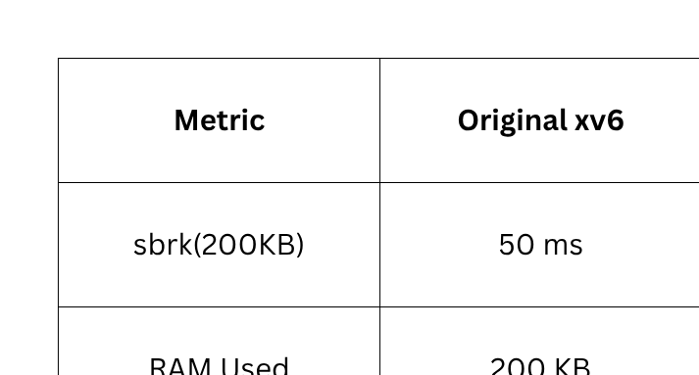
Performance Testing
Result
50x faster allocation
96% memory saving

Slide 14
Final Output
Final Statistics
Total Pages: 8
Allocated Pages: 8
Lazy Pages: 0
Total Page Faults: 8
Final Result
All tests passed!
Lazy allocation is working correctly!

Slide 15
Conclusion
Our project successfully:
implemented lazy page allocation in xv6-riscv
reduced memory waste
improved allocation speed
handled page faults dynamically
This project demonstrates:
How modern operating systems manage memory efficiently.

Slide 16
Thank You

